Slide 2
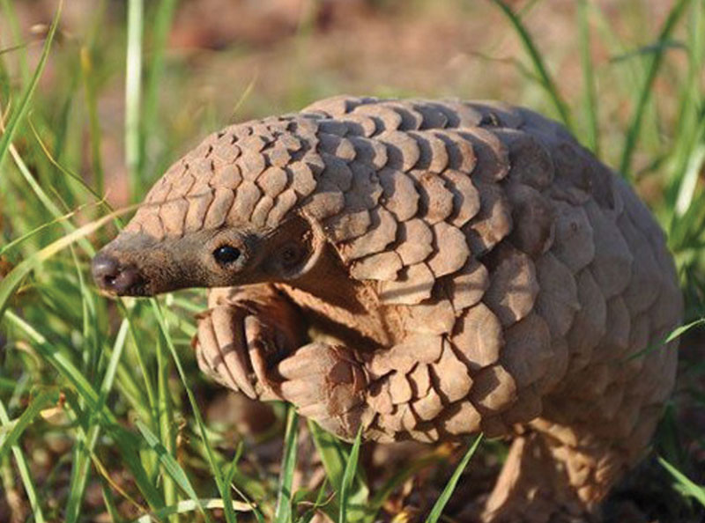
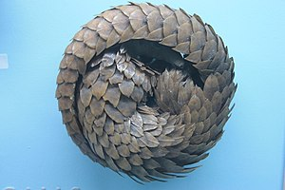
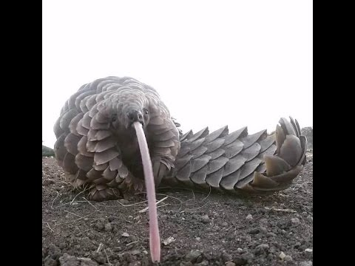
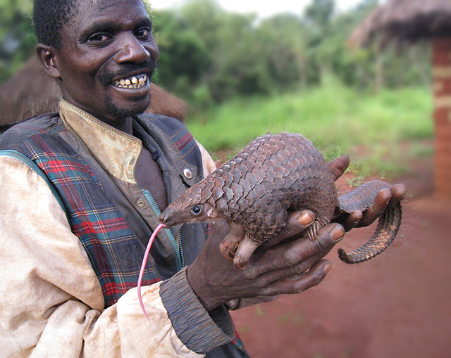
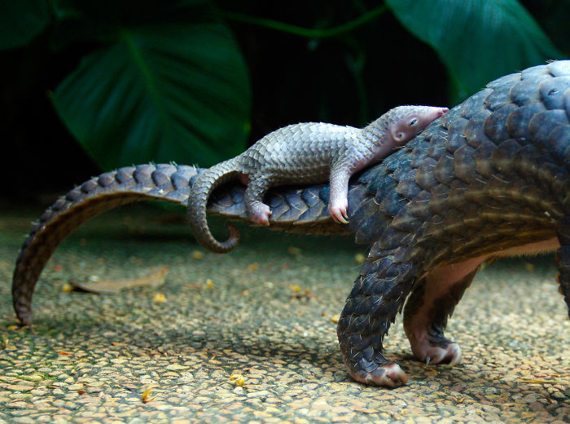
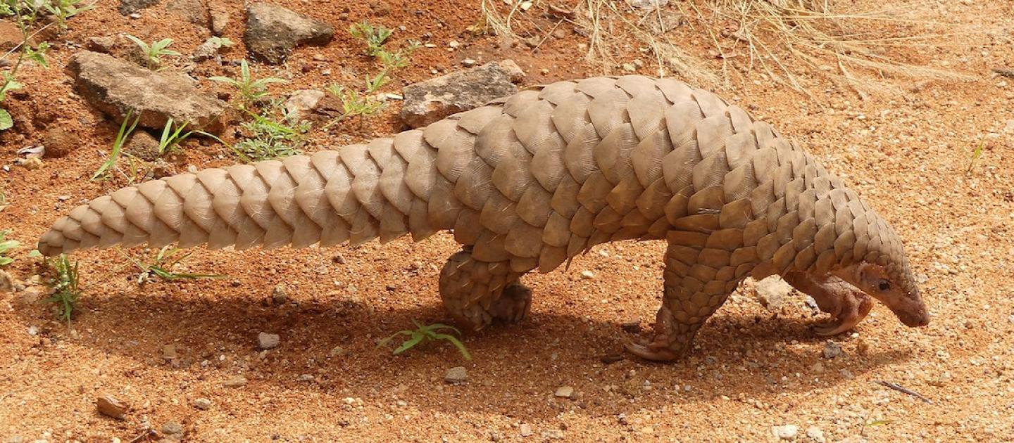
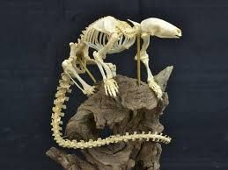
Ferae: Pholidota (8 sp)
Pangolins
Notes:
Four in Africa, four in Asia

Slide 3
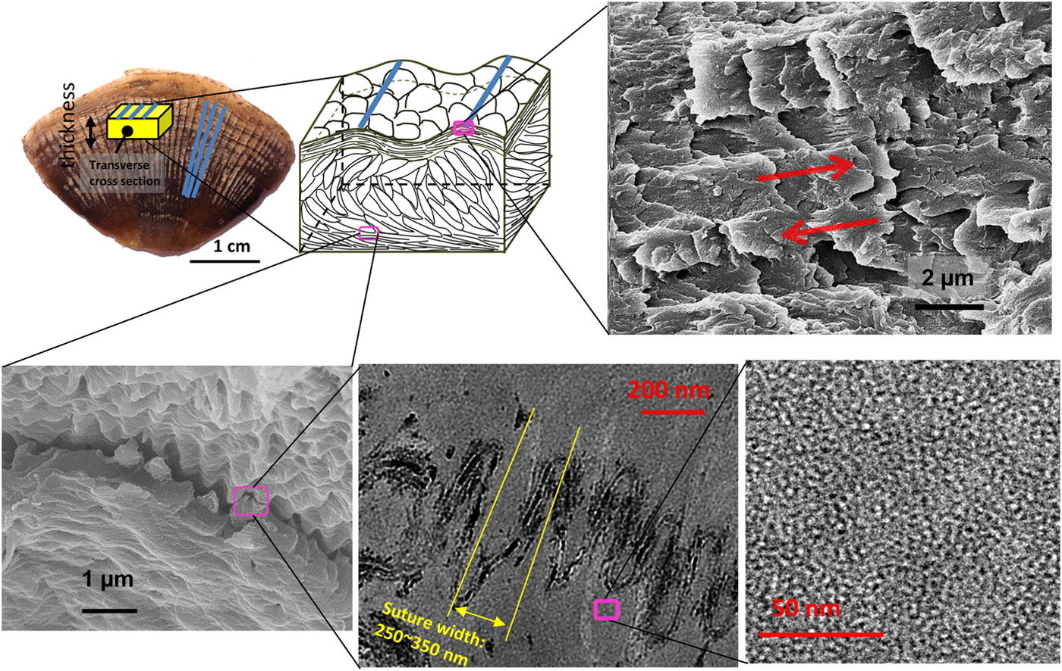
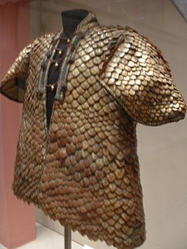
Ferae: Pholidota

Slide 4
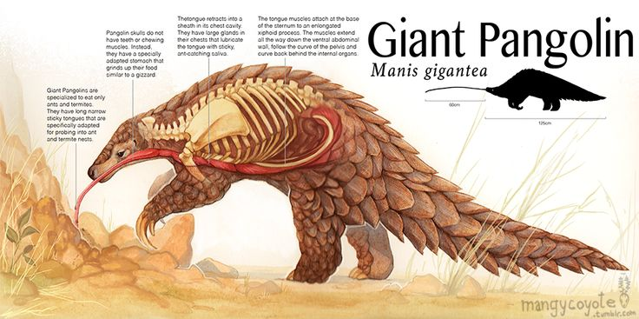
Ferae: Pholidota

Slide 5
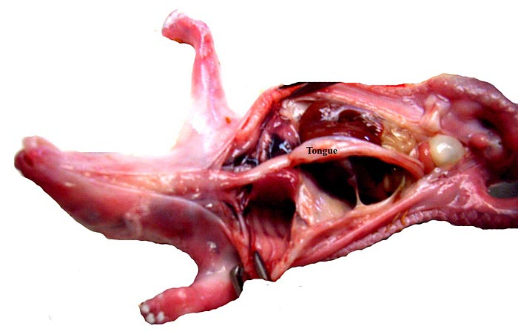
Ferae: Pholidota

Slide 6
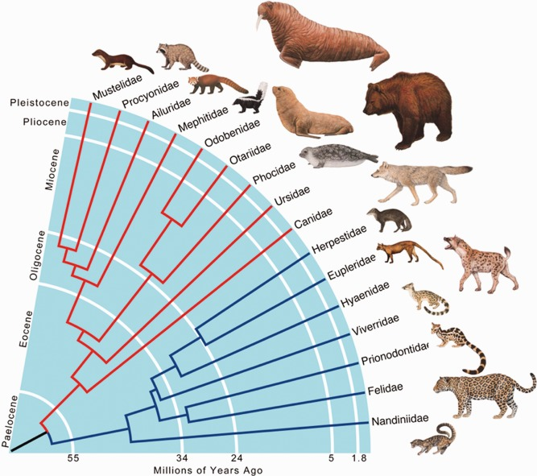
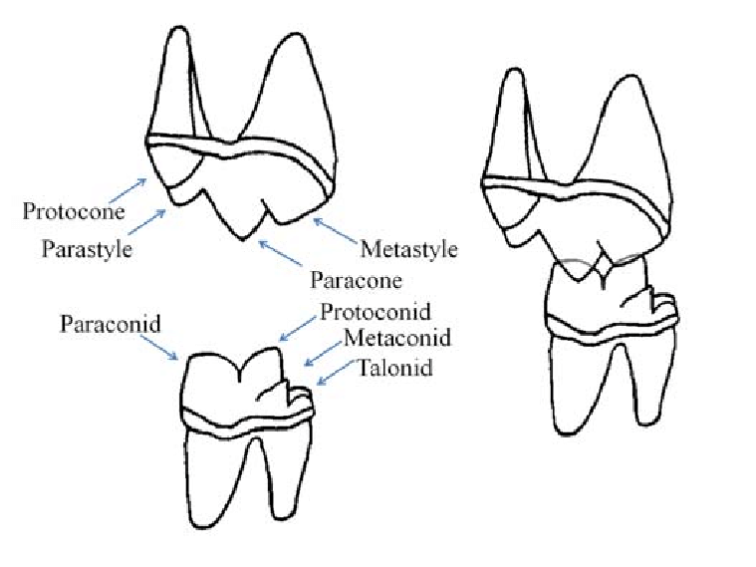
Ferae: Carnivora

Slide 7
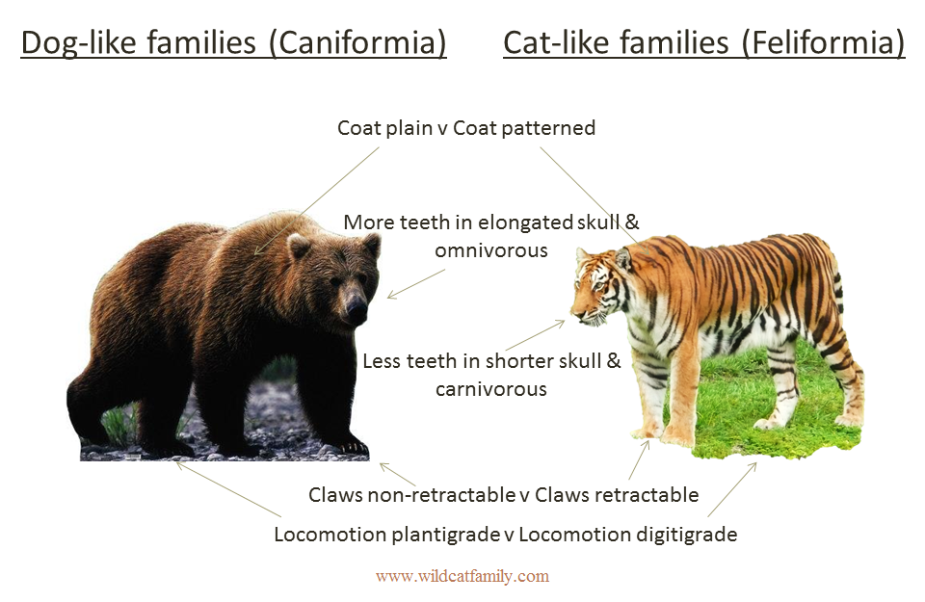
Ferae: Carnivora
Notes:
These are IN GENERAL. Major exceptions to all examples!

Slide 8
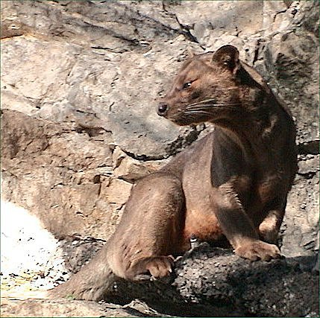
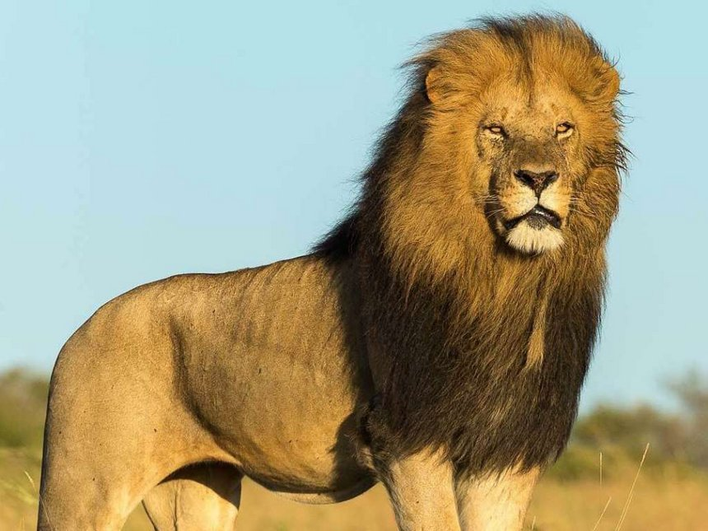
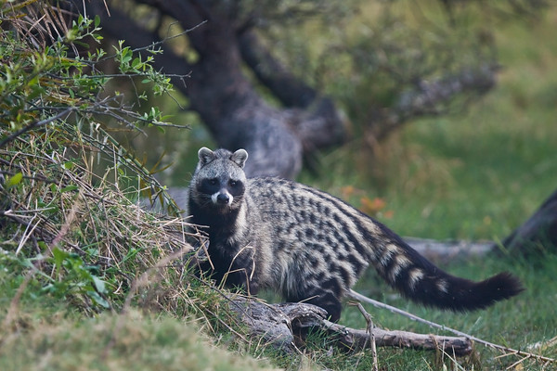
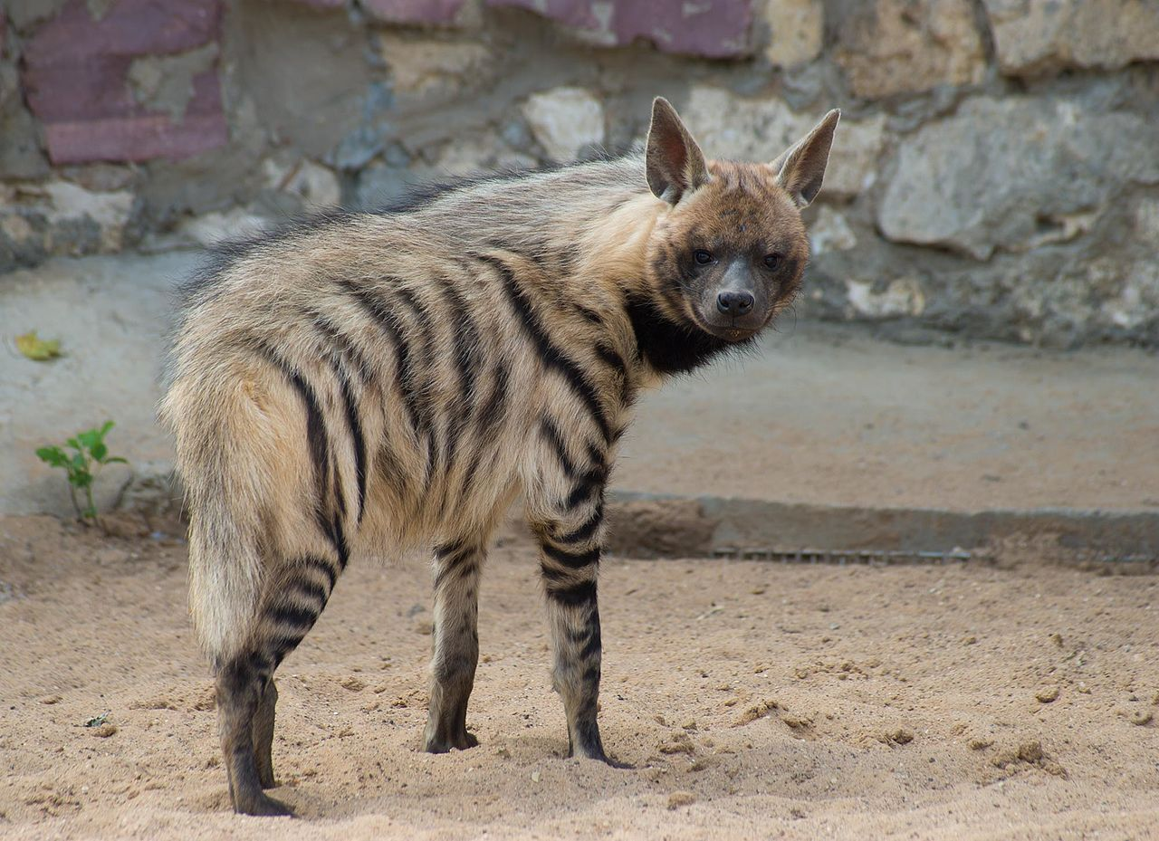
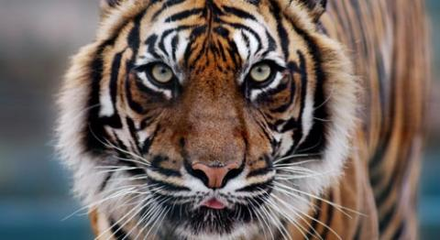
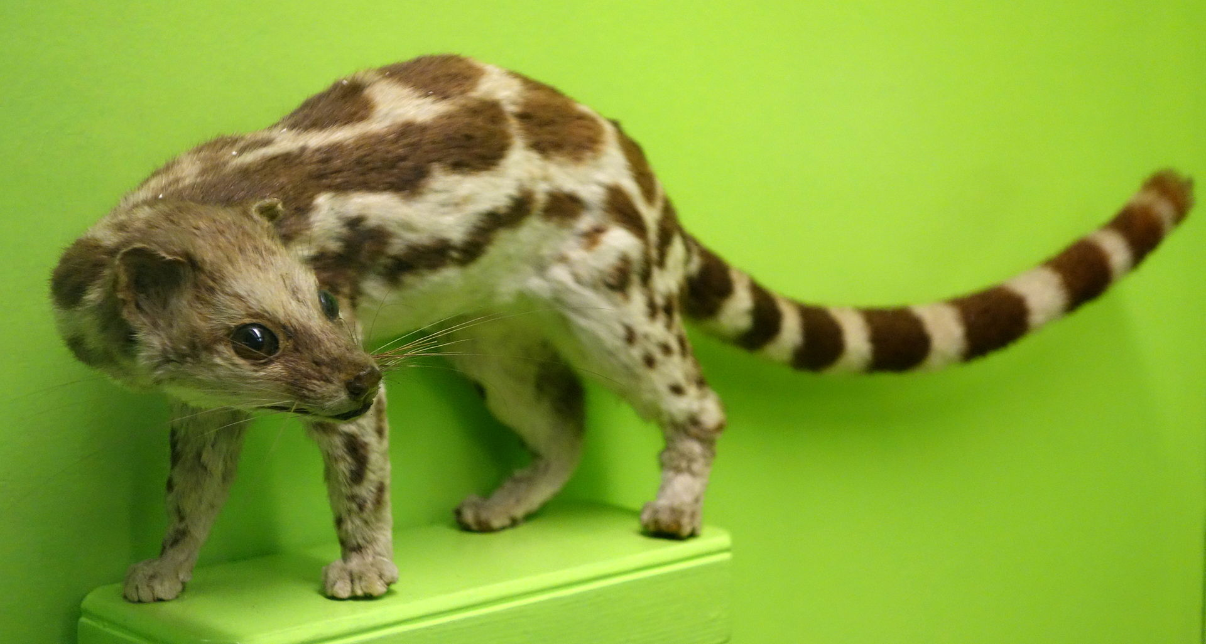
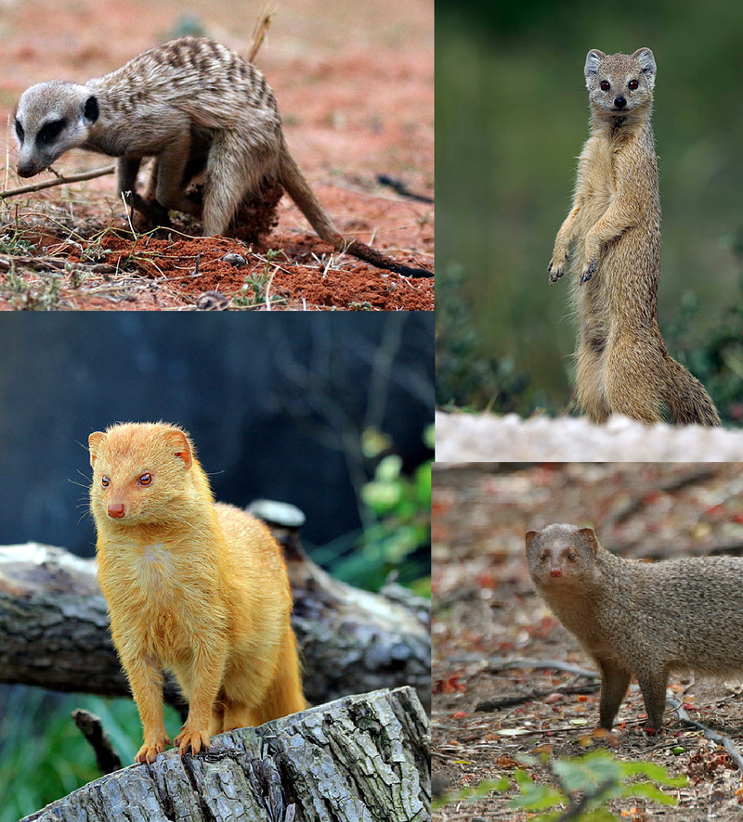
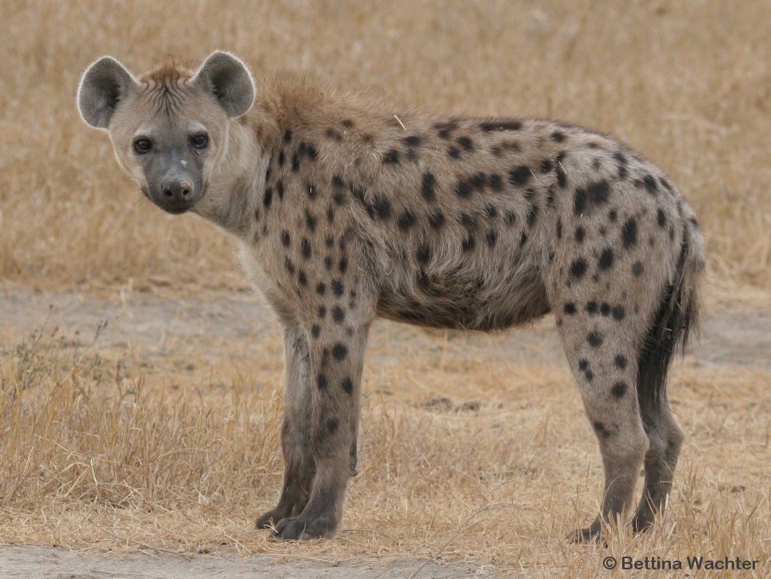
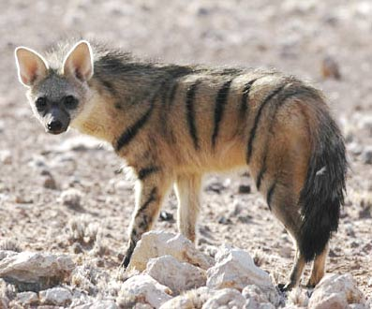
Ferae: Carnivora: Feliformia
Notes:
Viverridae = civets (top left)
Herpetidae = mongoose (bottom left)
Hyenas (middle column)
Cats (between hyenas and euplerids)
Euplerids =Malagasy mongoose (fossa) (top right)

Slide 9
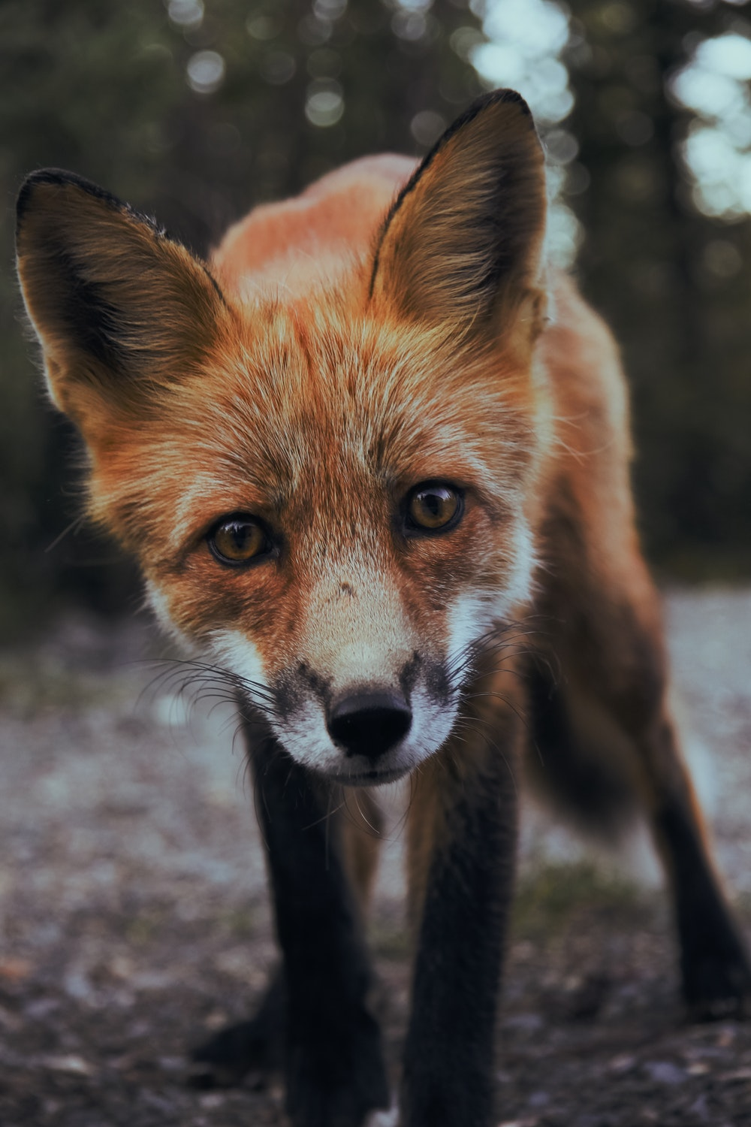
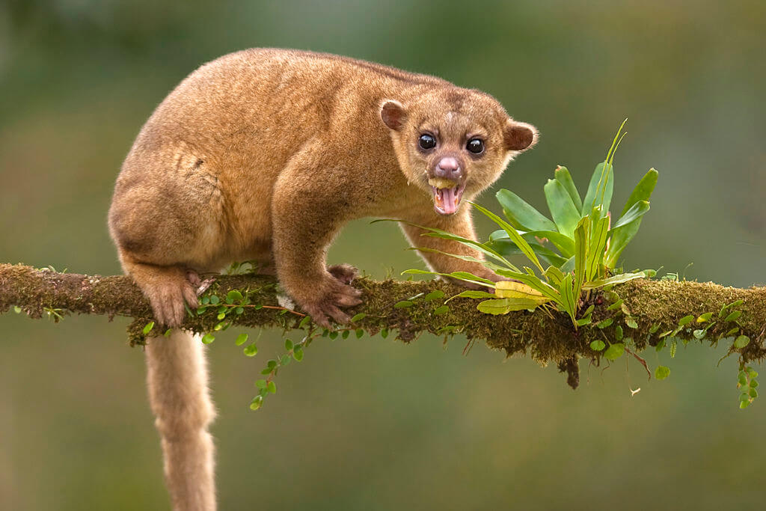
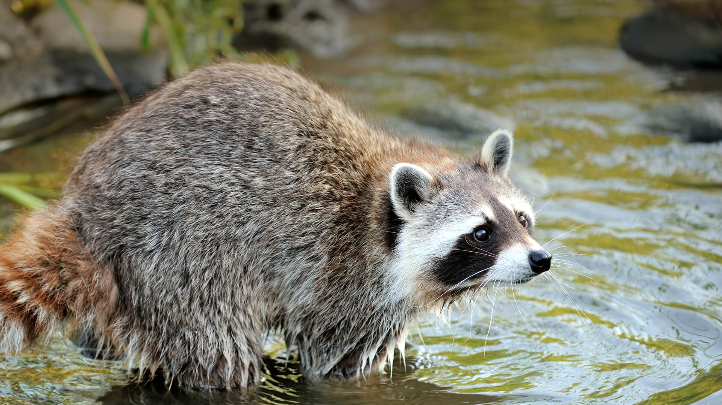
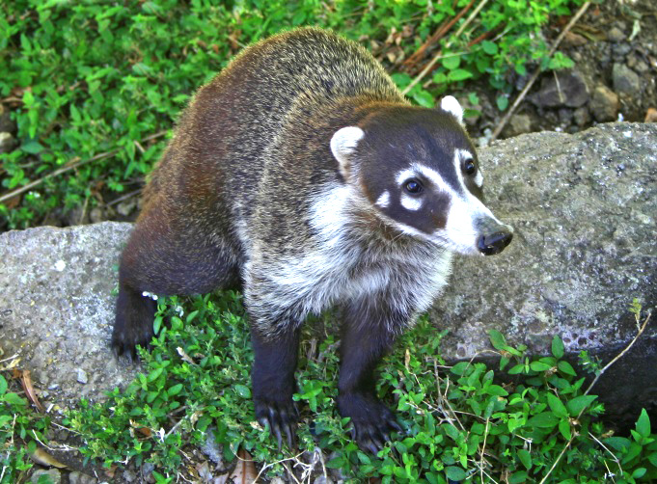
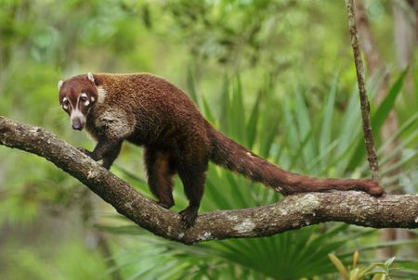
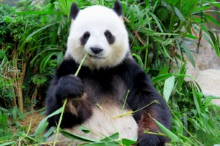
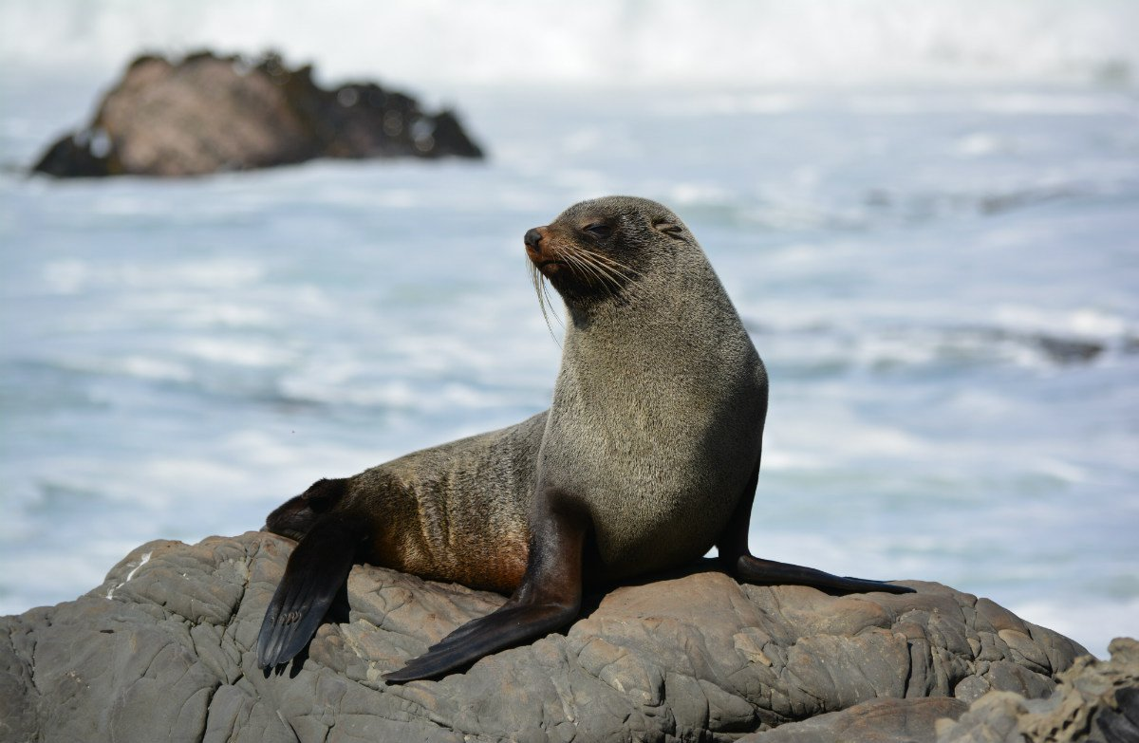
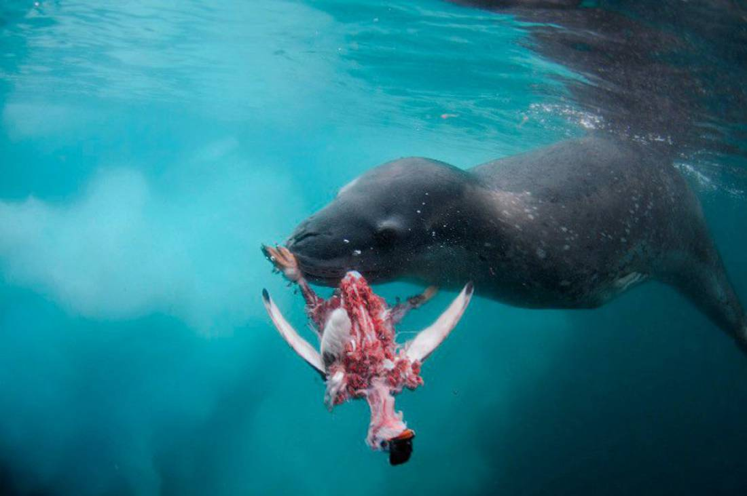
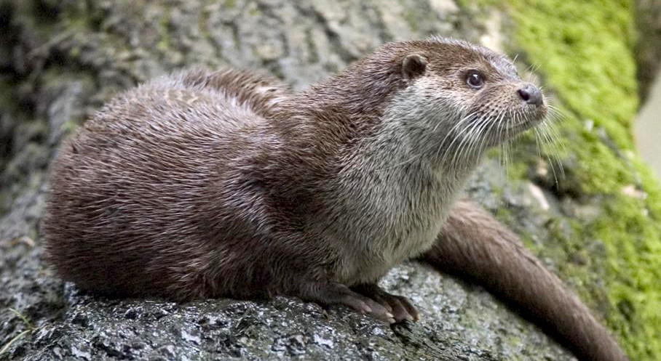
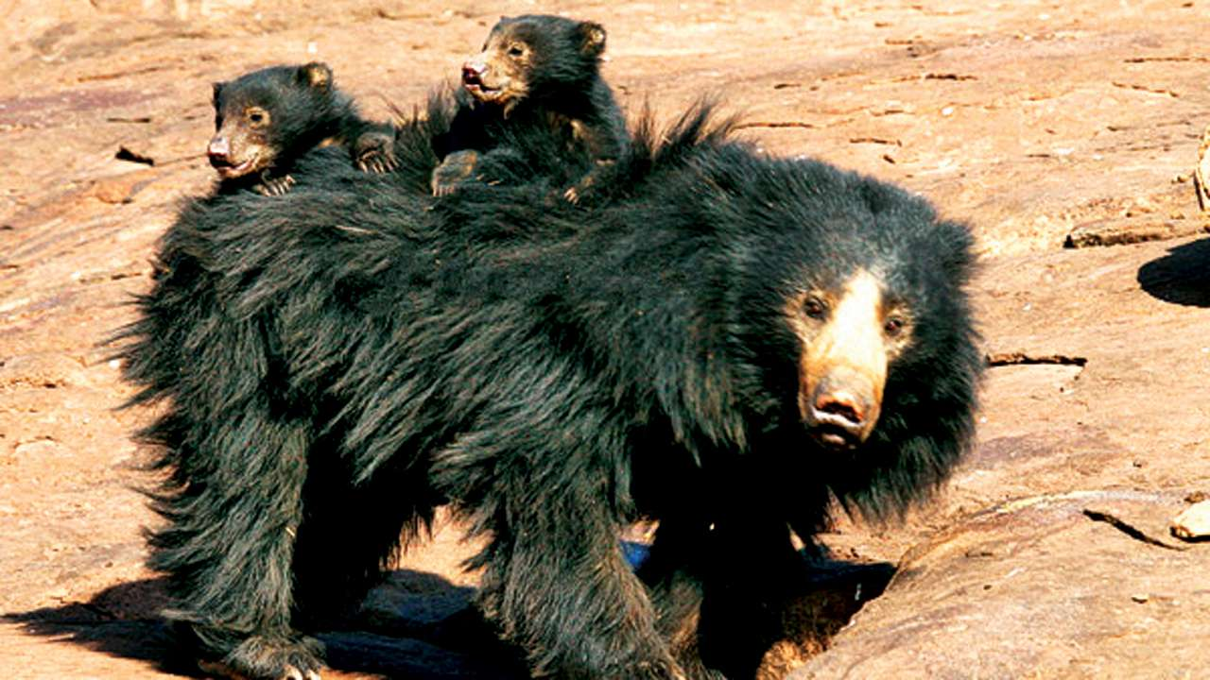
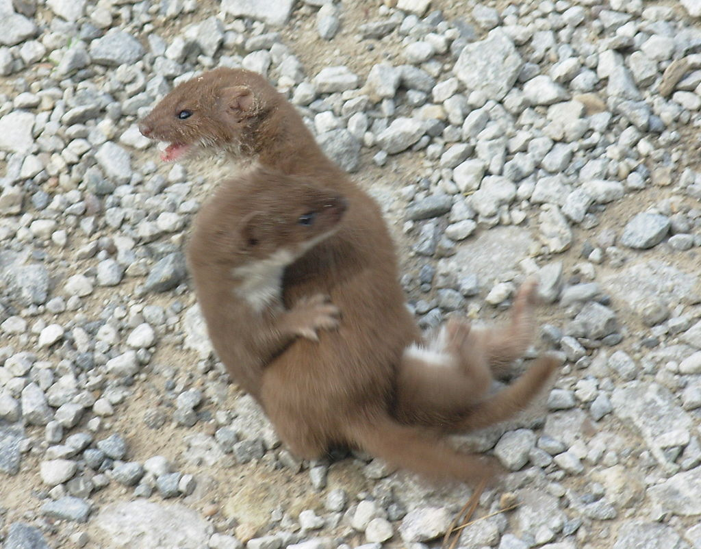
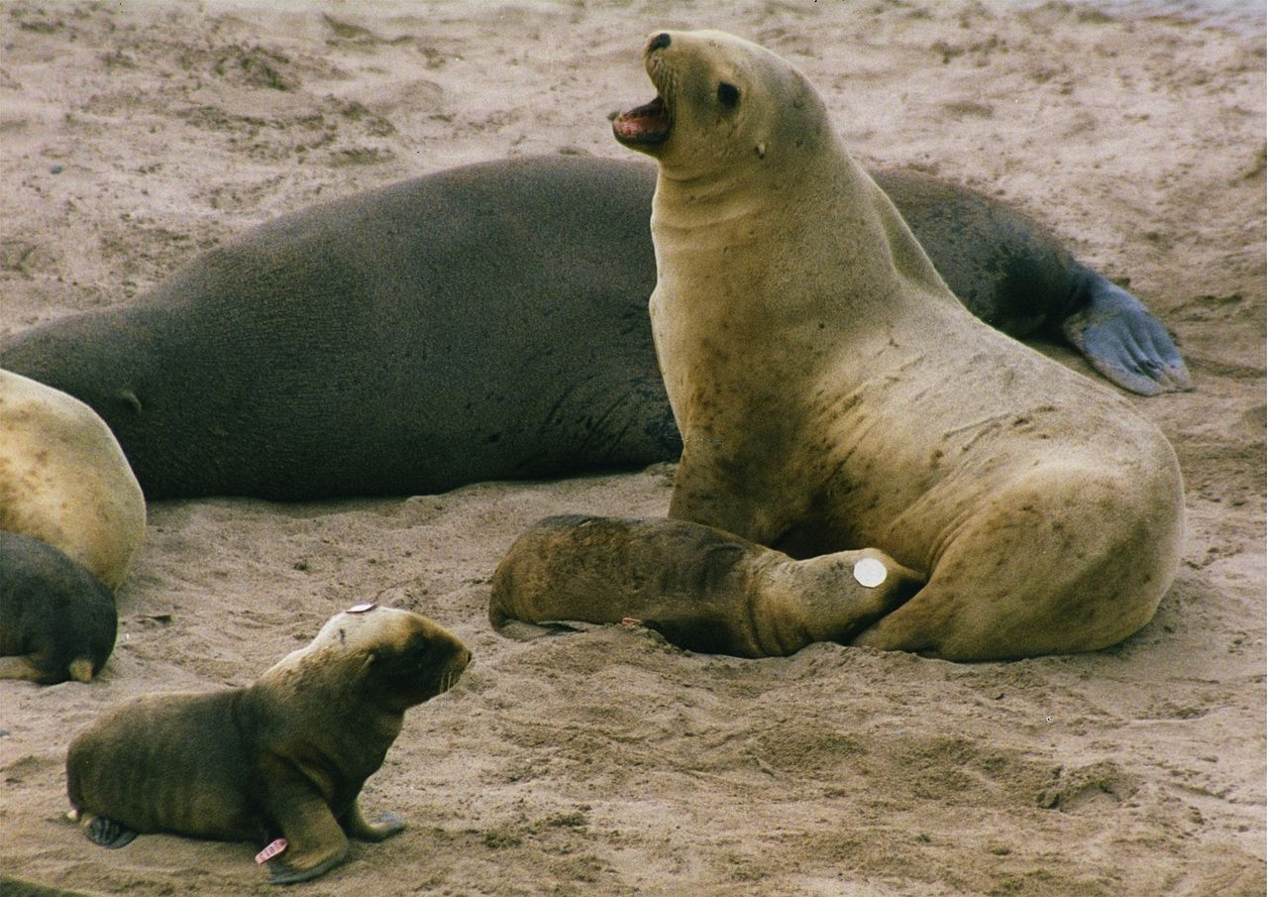
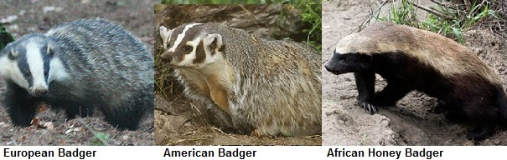
Ferae: Carnivora: Caniformia (~165 sp)
Notes:
Dogs, seals, bears, weasels, raccoons

Slide 10
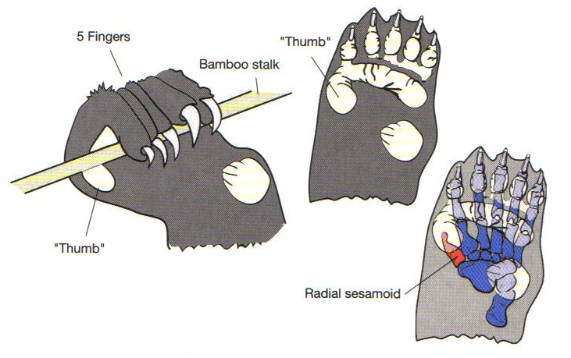
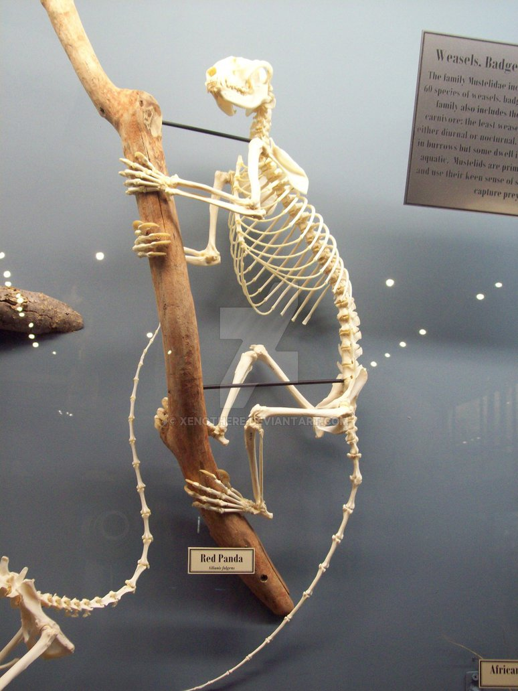
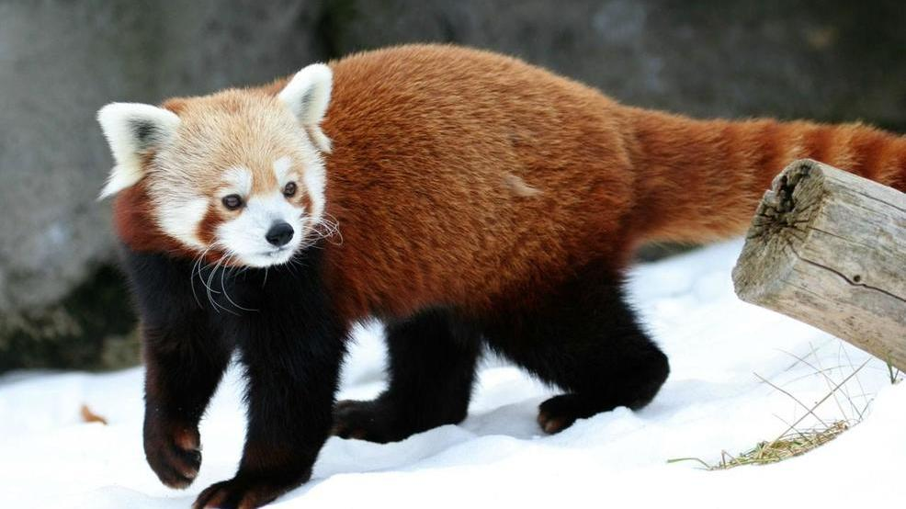
Ferae: Carnivora: Caniformia

Slide 11
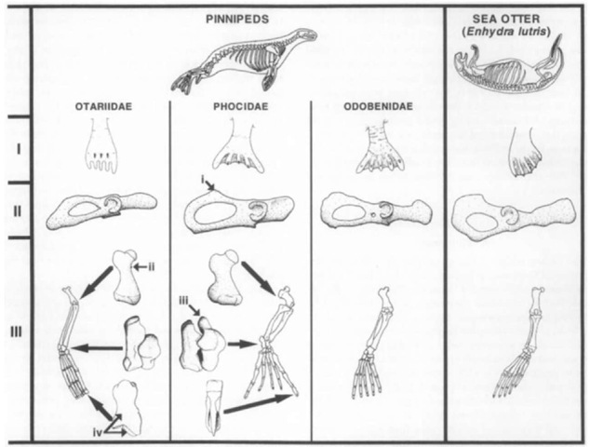
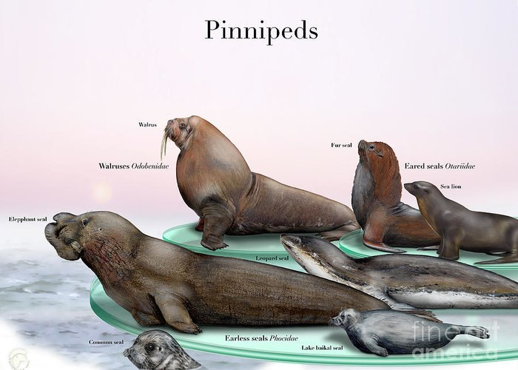
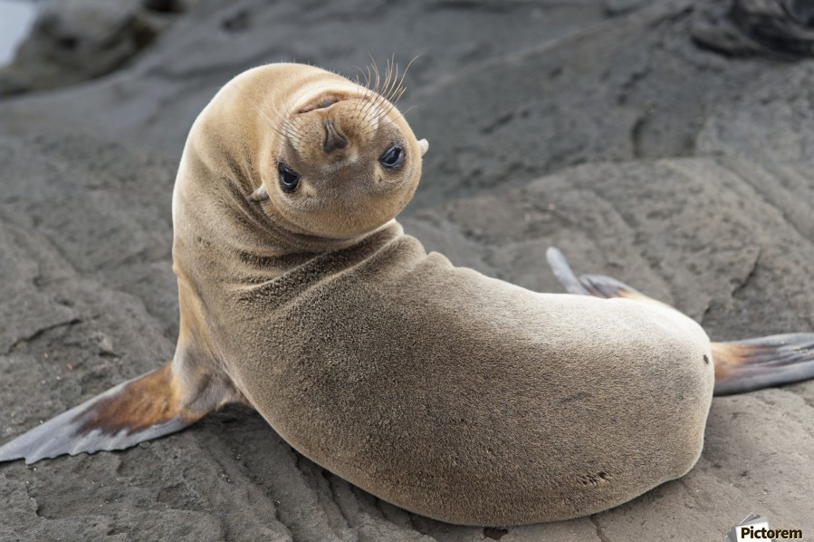
Ferae: Carnivora: Caniformia: Pinnipeds

Slide 12
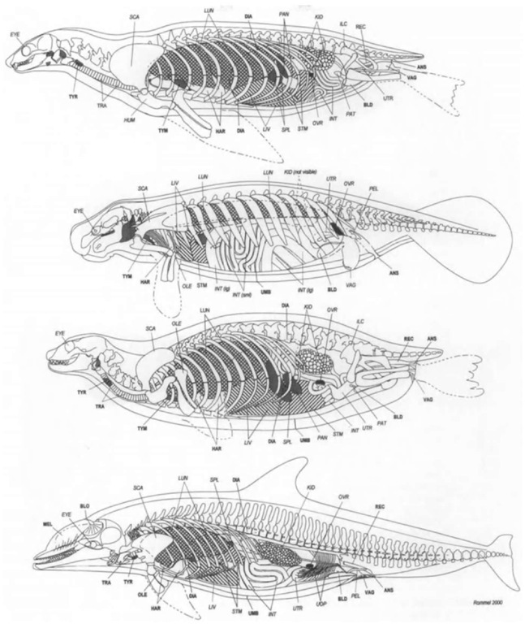
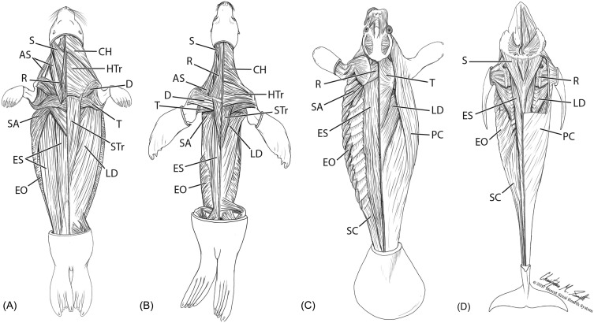
Returns to the Ocean!

Slide 13
Returns to the Ocean!

Slide 14
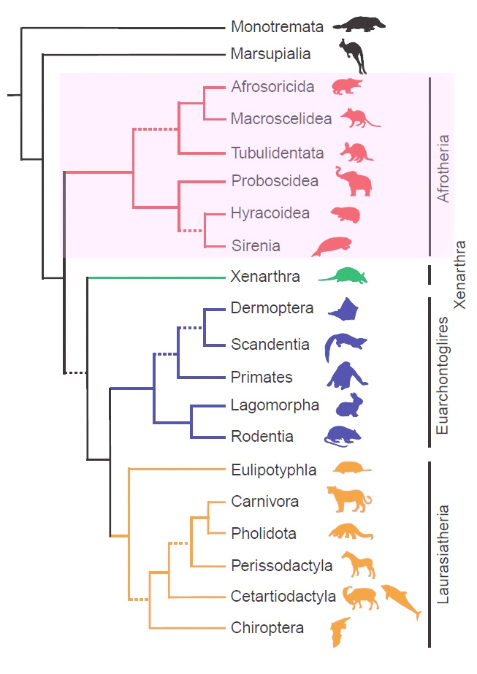
Euarchontaglires
Archonta
Glires

Slide 15
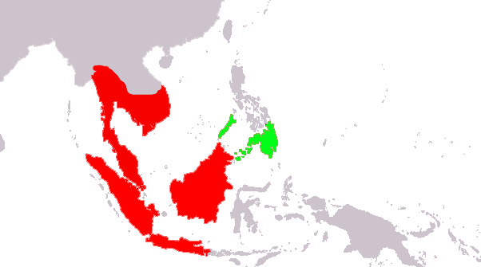
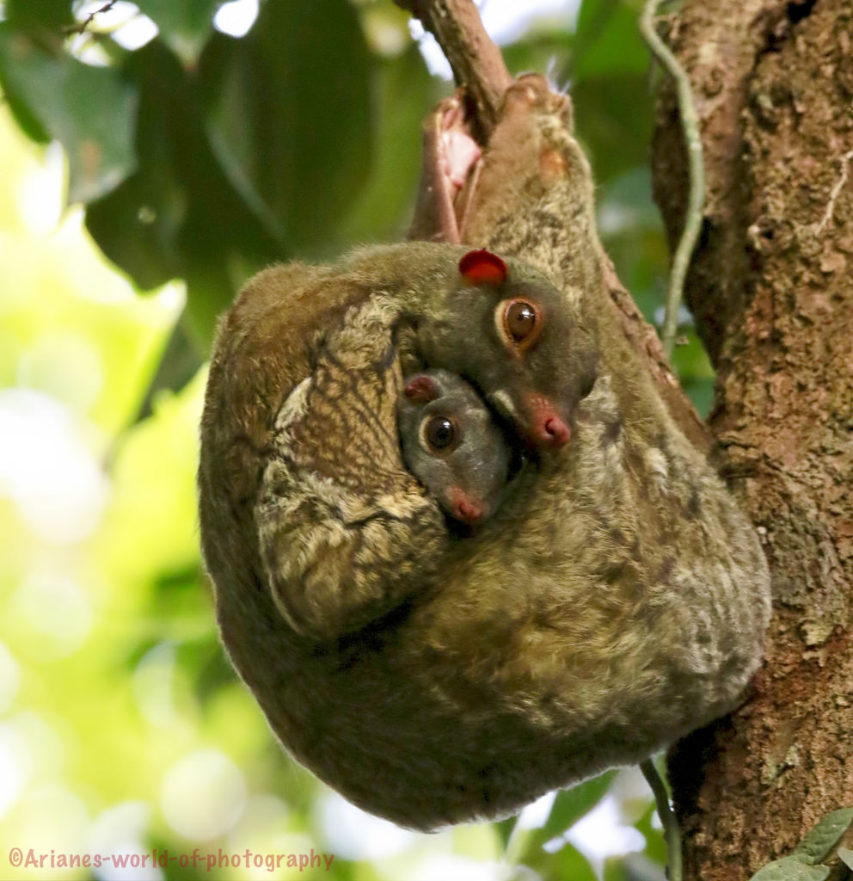
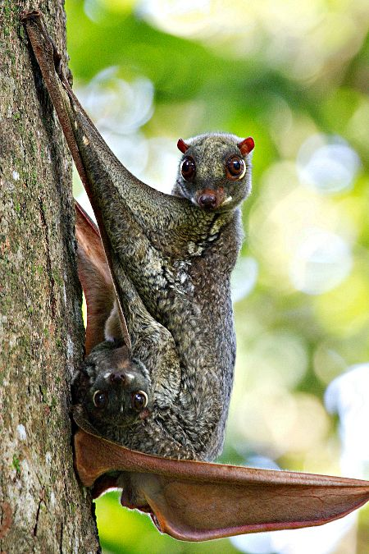
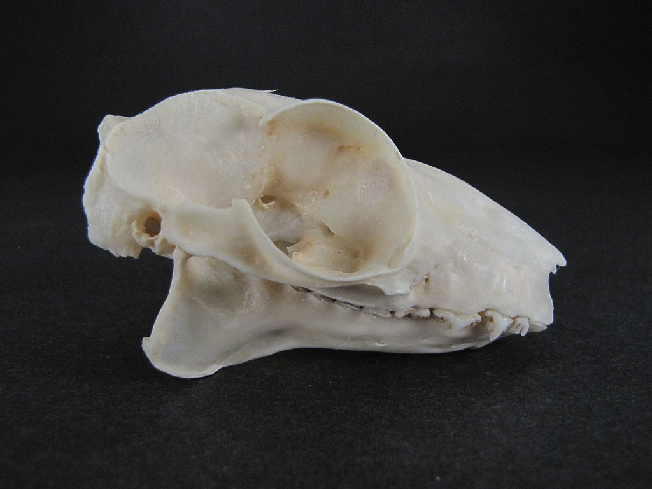
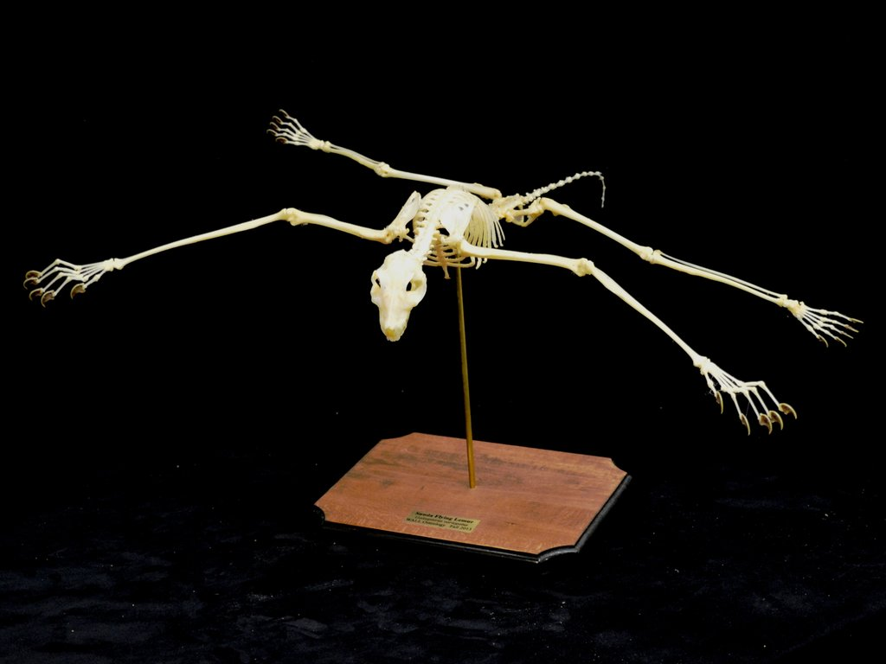

Archonta: Dermoptera (2 species)
Notes:
Tooth comb

Slide 16




Archonta: Scandentia (20 sp)

Slide 17

Archonta: Primates! (~650 species)

Slide 18

Archonta: Primates!

Slide 19











Archonta: Primates! Strepsirrhini (~150 species)
Lemurs, Lorises & Bushbabies
Notes:
Vitamin c

Slide 20


Archonta: Primates! Strepsirrhini
Lemurs, Lorises & Bushbabies
Notes:
Vitamin c

Slide 21

Archonta: Primates! Strepsirrhini
Notes:
Vitamin c
Note extreme extension of back during leap. Bushbabies use energy stored in elastic fibers and powerful extension to aid in their leap.

Slide 22




Archonta: Primates! Strepsirrhini
Tooth comb & tapetum lucidum
Notes:
Vitamin c

Slide 23


Archonta: Primates! Haplorrhini: Tarsiers (~ 7)

Slide 24


Archonta: Primates! Haplorrhini: Tarsiers (~ 7)
Only fully carnivorous primate
No tapetum lucidum

Slide 25



Archonta: Primates! Haplorrhini: Tarsiers (~ 7)
Only fully carnivorous primate
No tapetum lucidum
Notes:
Reflective structure to the choroid layer

Slide 26

Archonta: Primates! Haplorrhini: “Simians”

Slide 27






Archonta: Primates! Haplorrhini: Platyrrhini (~200 species)
“Flat nose” monkeys
New World

Slide 28




Archonta: Primates! Haplorrhini: Catarrhini

Slide 29

Archonta: Primates! Haplorrhini: Catarrhini

Slide 30

Archonta: Primates! Haplorrhini: Catarrhini
Notes:
https://www.youtube.com/watch?v=7iaQBIncj4M

Slide 31

Archonta: Primates! Haplorrhini: Catarrhini
Notes:
https://www.youtube.com/watch?v=7iaQBIncj4M

Slide 32


Glires – Over 40% of all mammals!

Slide 33



Glires: Lagomorpha (~70 species)
Rabbits & Pikas

Slide 34


Glires: Lagomorpha (~70 species)

Slide 35








Glires: Rodentia (2,500+ sp)

Slide 36

Glires: Rodentia

Slide 37



Glires: Rodentia

Slide 38





Glires: Rodentia

Slide 39

Glires: Rodentia

Slide 40

Glires: Rodentia

Slide 41

Glires: Rodentia

Slide 42


Glires: Rodentia

Slide 43


Glires: Rodentia

Slide 44



Glires: Rodentia
Notes:
Reduced pain reception
Essentially no homeothermy
No cancer
Eusociality
“In response to high temperatures and inflammation around sensory neurons, nerve growth factor (NGF) molecules bind to a receptor called TrkA. This kicks off a cascade of chemical signals that "sensitize" an ion channel -- called TRPV1 -- on the surface of the sensory neuron so that it opens. Once TRPV1 opens, it results in sensory nerve firing that tells the brain to register pain at temperatures that are not normally painful.”

Slide 45

Glires: Rodentia

Slide 46


Slide 47

“Shrews”: A Return to Form
Shrew opossums (Metatheria: Paucituberculata)
Elephant shrews (Afrotheria: Macroscelidea)
True shrews (Laurasiatheria: Euliptophyla)
Tree shrews (Archonta: Scandentia)

